Slide 1
Computer Networks _22CS008
Routing Information Protocol (v1 & v2)
Lecture 34-36 (Theory)
Prepared by:
Dr. Suvarna Sharma
Department of Computer Science and Engineering,
Chitkara University, Punjab

Slide 2
Index
Introduction
OVERVIEW ON ROUTING PROTOCOLS
WHAT IS THE RIP? AND WHY?
RIP CHARACTERISTICS
Routing Information Protocol Versions
Routing Information Protocol Description
Routing Information Protocol Limitations

Slide 3
Routing Information Protocol
Any routing protocol has to be characterized depend on its type that may be :
Single / Multipath protocol.
Flat / Hierarchical protocol.
Interior / Exterior protocol.
Link state / Distance vector protocol.

Slide 4
What is RIP?
The Routing Information Protocol (RIP) is one of the oldest routing protocols which employ the hop count as a routing metric.
It is an interior, distance-vector protocol for small networks.
One of the first IPs
The maximum number of hops allowed for RIP is 15, which limits the size of networks that RIP can support.
A hop count of 16 is considered an infinite distance and the route is considered unreachable.

Slide 5
Why RIP?
Early requirements to exchanges data between computers over interconnected networks.
Routing entities had to make a judgement on which path to route traffic to destination.
SO, RIP prevents routing loops by implementing limit on the number of hops allowed in a path from source to destination.
RIP (Routing Information Protocol) is a standard for exchange of routing information among gateways and hosts.

Slide 6
RIP Characteristics
RIP prevents routing loops by implementing a limit on the number of hops allowed in a path from the source to a destination.
The maximum number of hops allowed for RIP is 15.
This hop limit, however, also limits the size of networks that RIP can support.
A hop count of 16 is considered an infinite distance and used to deprecate inaccessible, inoperable, or otherwise undesirable routes in the selection process.

Slide 7
Cont….
Originally each RIP router transmitted full updates every 30 seconds.
In the early deployments, routing tables were small enough that the traffic was not significant.
As networks grew in size, however, it became evident there could be a massive traffic burst every 30 seconds, even if the routers had been initialized at random times.
RIP uses the User Datagram Protocol (UDP) as its transport protocol, and is assigned the reserved port number 520.

Slide 8
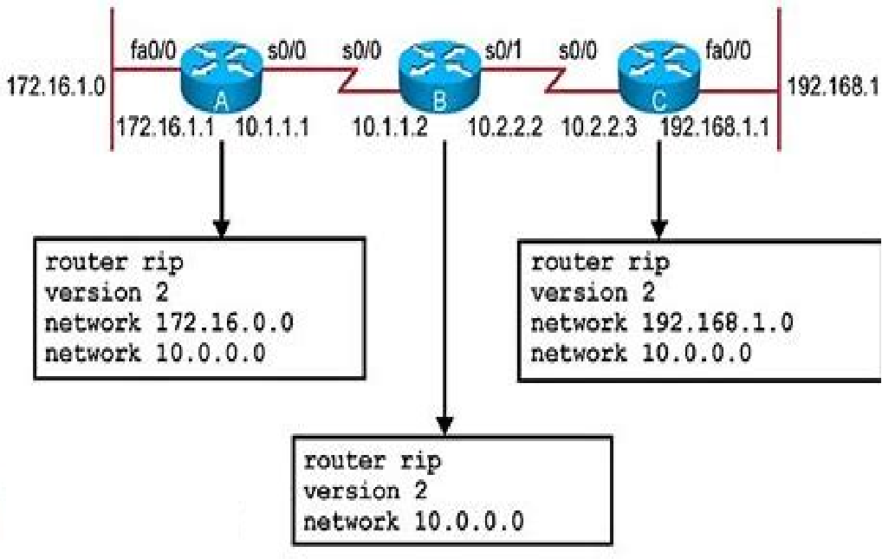
RIP: Configuration
Figure:1 RIP Configuration

Slide 9
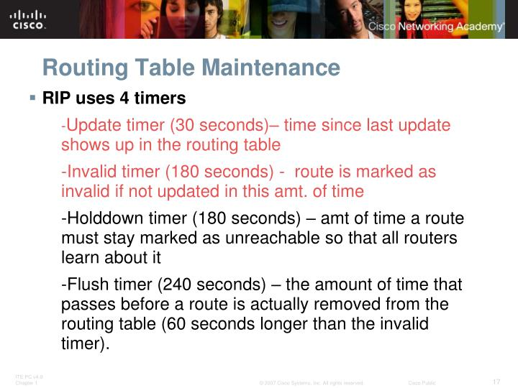
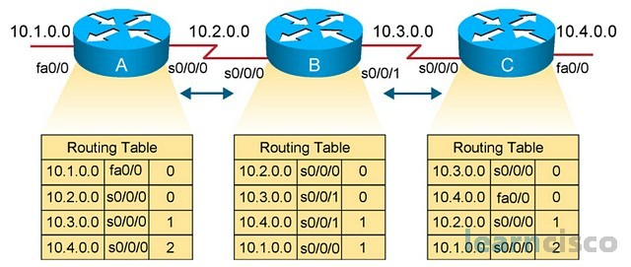
RIP: Configuration Routing Loop
Routing Table Maintenance
Figure: 2 Chain Reaction of Network Information Transfer from C to A
Routing Loop

Slide 10
Routing Loop :Maximum Hop Count
Figure: 3 Hop count

Slide 11
Versions of RIP
There are two versions of the Routing Information Protocol:
RIP version 1
RIP version 2

Slide 12
RIP v1
Now let’s look at some differences between the different versions of RIP: RIP v1 uses what is known classful routing.
Classful addressing is the use of Class A, Class B, and Class C addresses. (Class D is reserved for multicasts, and Class E is reserved for future use.) Class A, B, and C addresses define a set number of binary bits for the subnet portion.
For example, a Class A network ranges from 1–127 and uses a subnet mask of 255.0.0.0.
A Class B network uses the mask 255.255.0.0, and Class C uses 255.255.255.0.
RIP v1 does not support authentication of update messages (plain-text or MD5). RIP v1 is an older, no longer much used routing protocol.

Slide 13
RIP v2
RIP v2 is a classless protocol and it supports classful, variable-length subnet masking (VLSM), CIDR, and route summarization.
RIPv2 supports authentication of RIPv2 update messages (MD5 or plain-text).
Authentication helps in confirming that the updates are coming from authorized sources.
It also supports multicast routing updates to reduce resource consumption (as opposed to using broadcasting in RIP v1).
RIP v2 can be useful in small, flat networks or at the edge of larger networks because of its simplicity in configuration and usage.

Slide 14
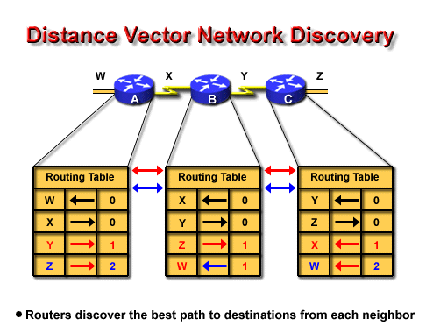
RIP Description
IGP
Distance vector protocol
Bellman-Ford Alg.
Uses table exchange
Idea of RIP
Send routing table
Receive inf.
Decide updating
Send an updated routing advertisement
Receive from/send to directly neighbors
Figure: 4 Route Discover the best path to destination from each neighbor

Slide 15
RIP Limitations
Without using RMTI (Metric-based Topology Investigation), Hop count can not exceed 15, in the case that it exceeds this limitation, it will be considered invalid.
Most RIP networks are flat. There is no concept of areas or boundaries in RIP networks.
Variable Length Subnet Masks were not supported by RIP version 1.
Without using RMTI, RIP has slow convergence and count to infinity problems.

Slide 16
WHAT ARE THE DIFFERENCES BETWEEN RIP VERSIONS?

Slide 17
Practice Questions
Which transport protocol used by RIP?
UDP (User Datagram Protocol).
TCP (Transmission Control Protocol)
HTTP
HTML
Identify the correct command to display RIP routing updates?
Show IP route
Debug IP rip
Show protocols
Debug IP route
Choose the correct Default administrative distance of a static route.
0
90
120
1

Slide 18
Practice Questions
Methos used by RIPv1 to send RIP message to every neighbor?
Unicasting
Broadcasting
Multicasting
Both Unicasting and Broadcasting
Maximum Hop count for RIP is ____
255
16
99
15

